Slide 1
EENG 385 555 Timer
Notes:
Usually the <title of the lab> is what will be called the “System” through the rest of this document

Slide 2
Lab Instructor Bio
Introduce yourself to the class.
Where is your hometown?
Family?
Pets?
What sorts of activities do you enjoy?
What sorts of unique life experiences would you like to share?
Pictures, pictures, pictures.

Slide 3
Lab Objectives
Introduce you to construction and simulation using the MultiSim Live tool using a circuit that is part of the BJT curve tracer.

Slide 4
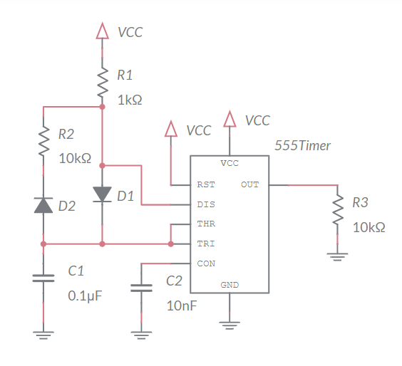
Analyze
Produces oscillating waveform
Low duty cycle
Will be used later in curve tracer
Notes:
Replace <System> with the name of the

Slide 5
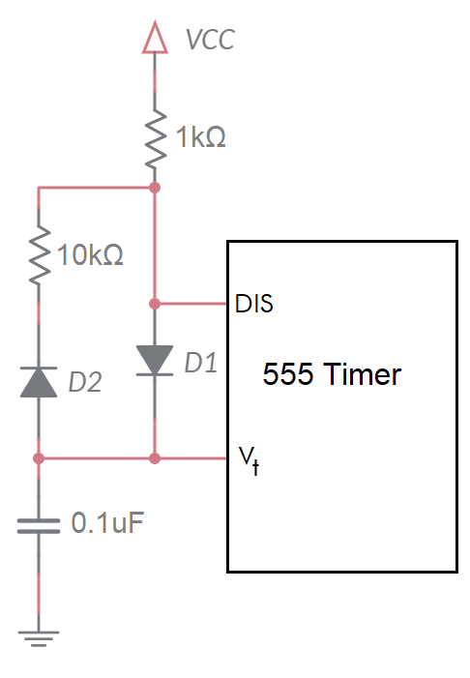
Analyze
DIS pin is either open circuit or GND
Open circuit = charging 10nF capacitor
GND = discharge 10nF capacitor
Charging Mode
1k and 0.1uF in series
Determine time to charge cap from 3V to 6V
Discharging Mode
10k and 0.1uF in series
Determine time to discharge cap from 6V to 3V
Notes:
Replace <System> with the name of the

Slide 6
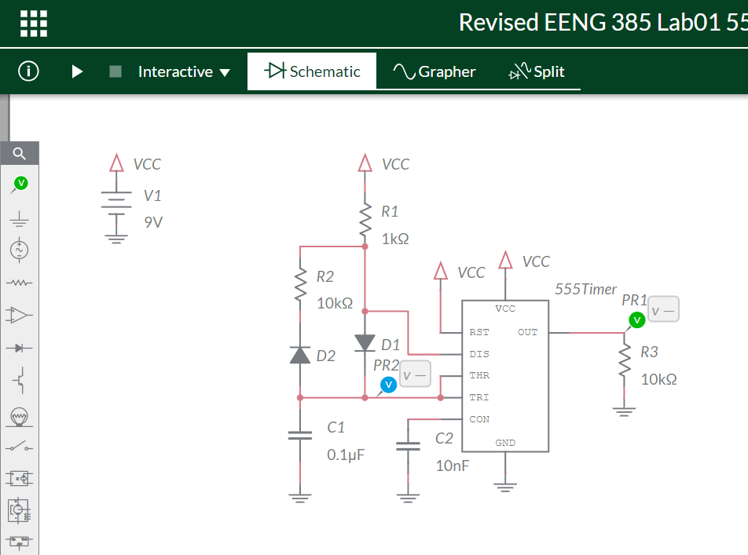
Simulate
Create Multisim Live account
Use interface to
Select parts
Position parts
Connect parts
Assign component values

Slide 7
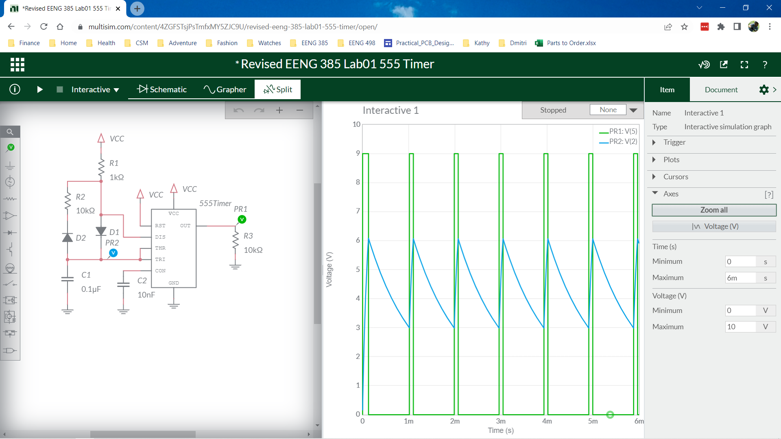
Simulate
Add probes
Set simulation time

Slide 8
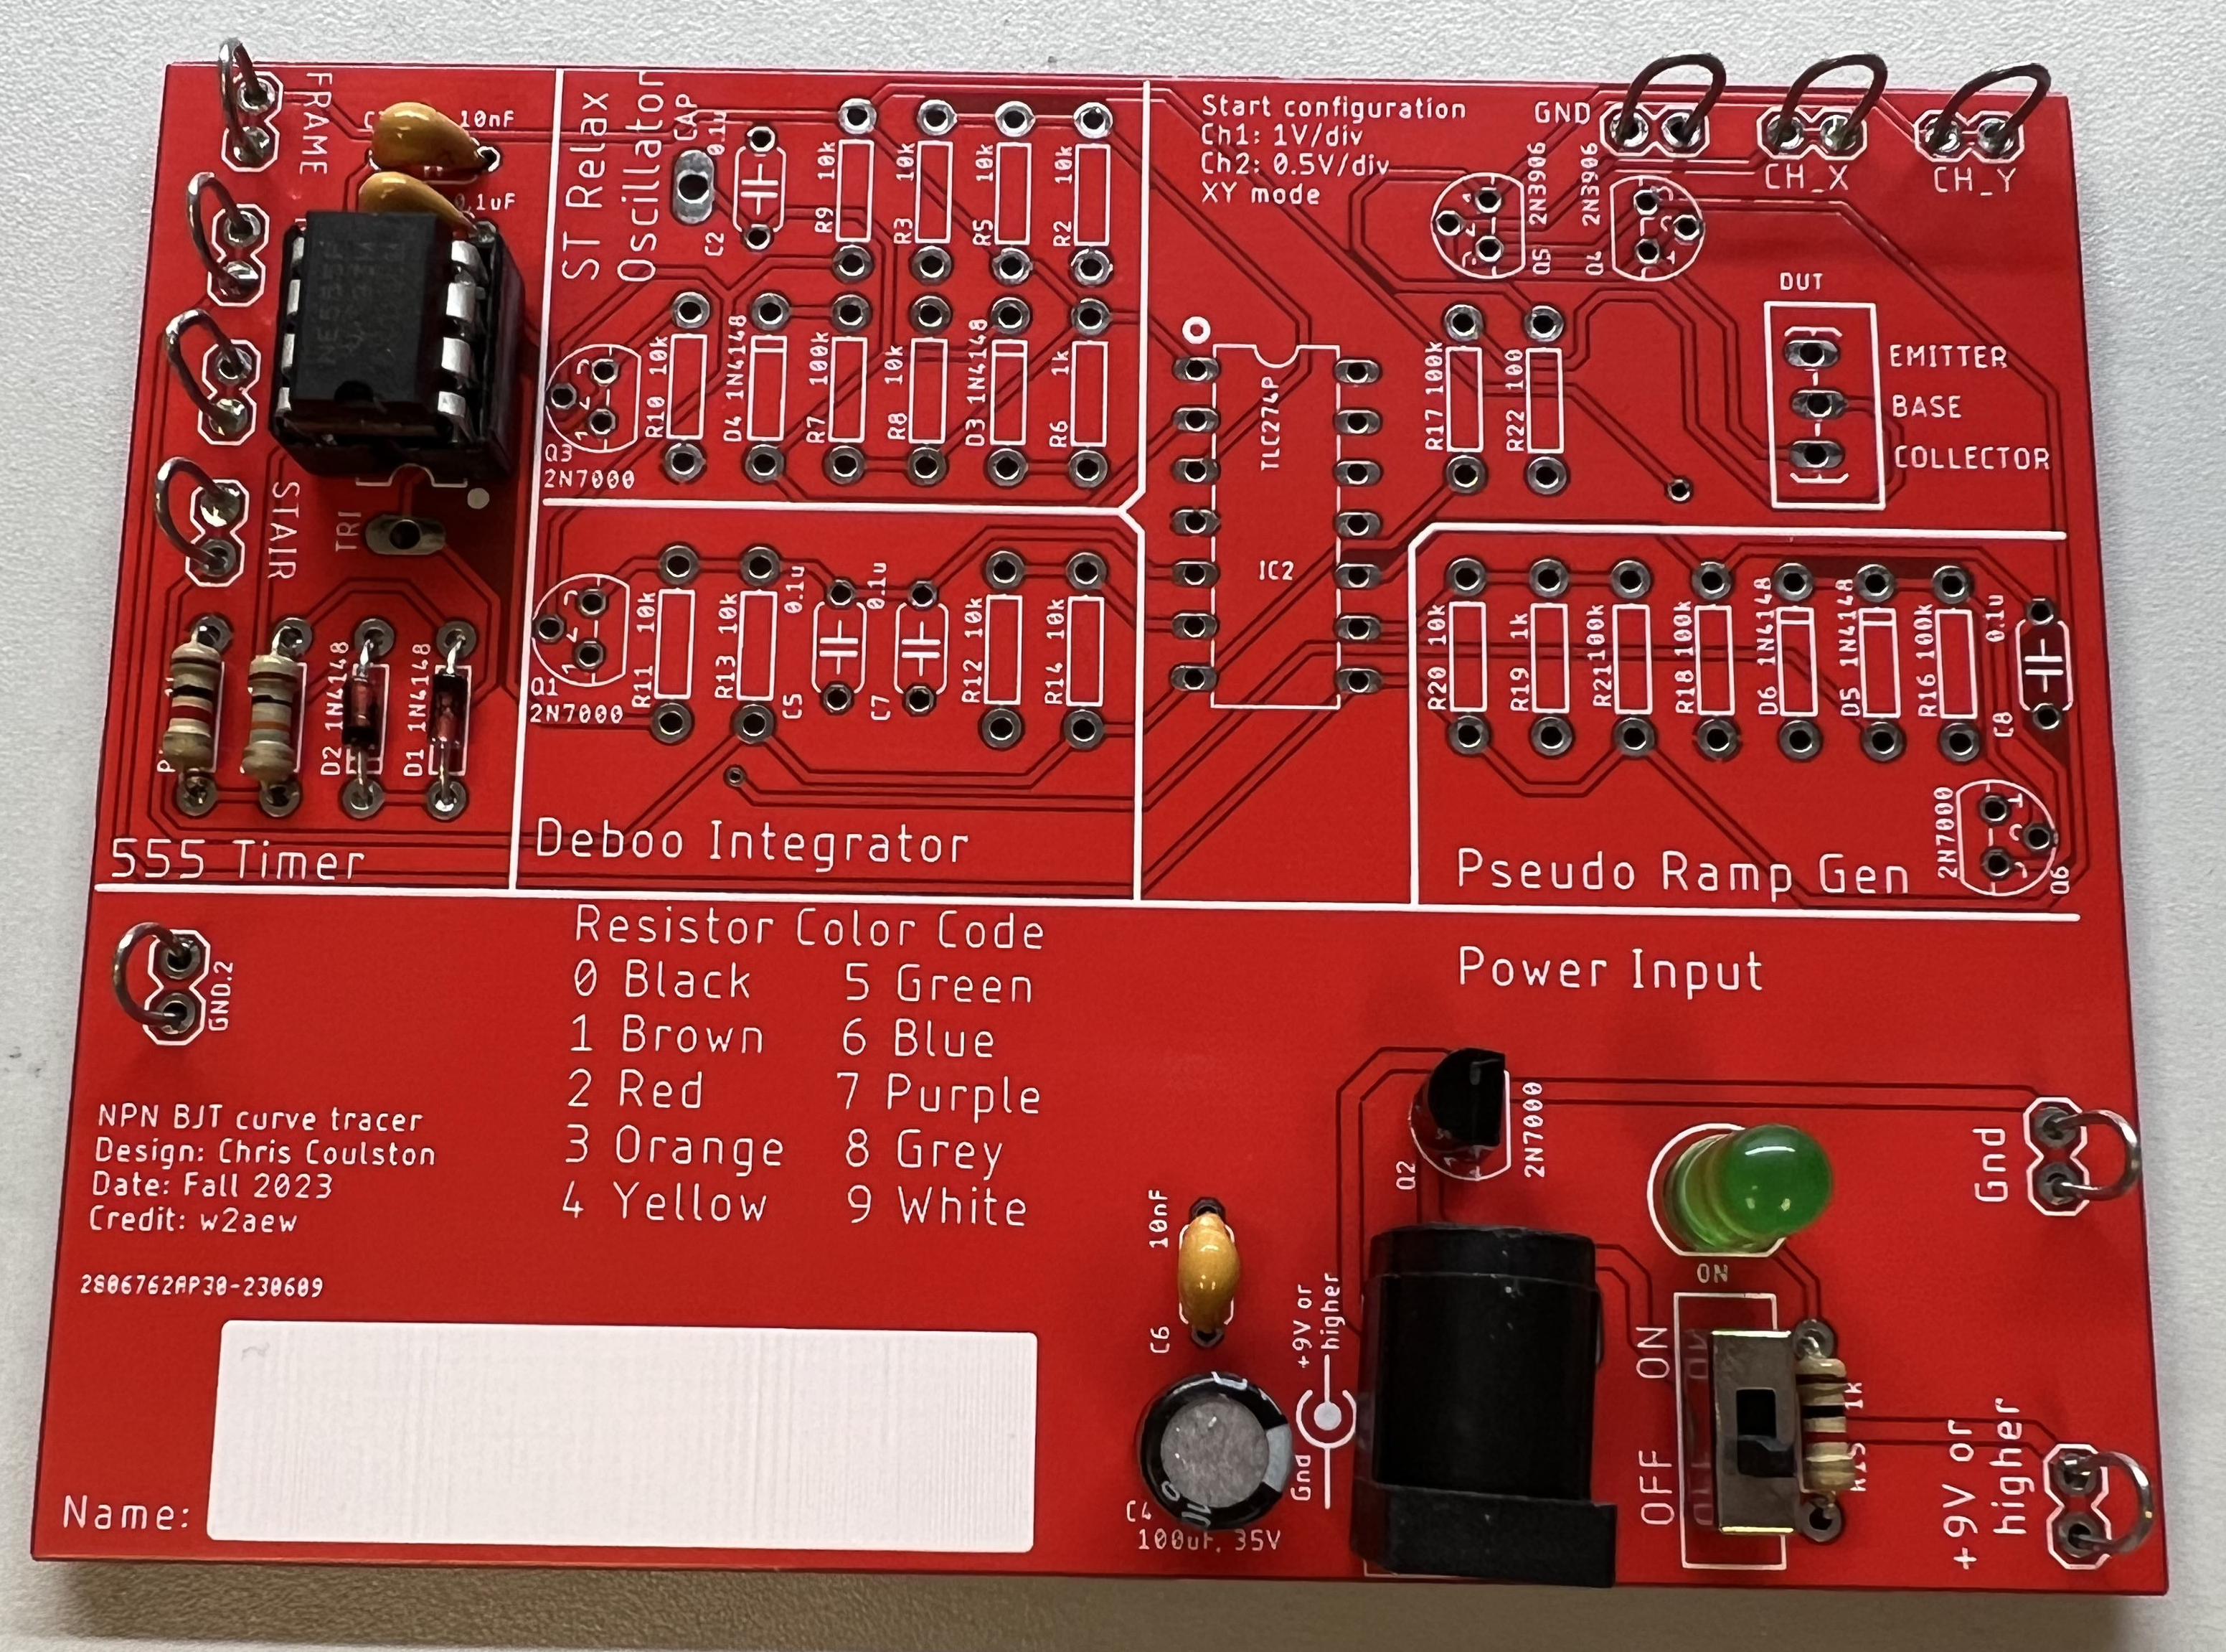
Assemble
Assemble 555 and PWR
Nothing else!
Use eye protection
Solder in Brown 303
Apply power using Vcc Gnd
Reverse voltage protection

Slide 9
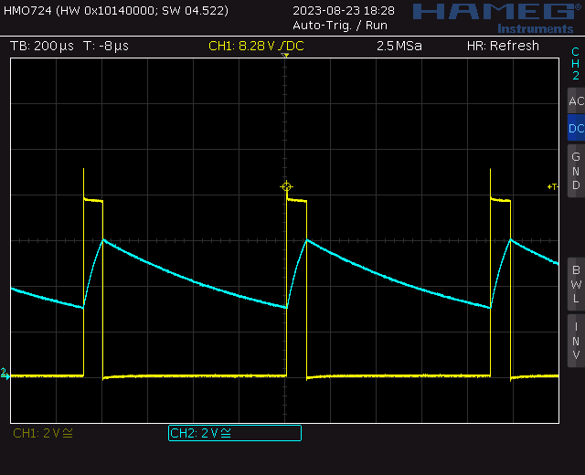
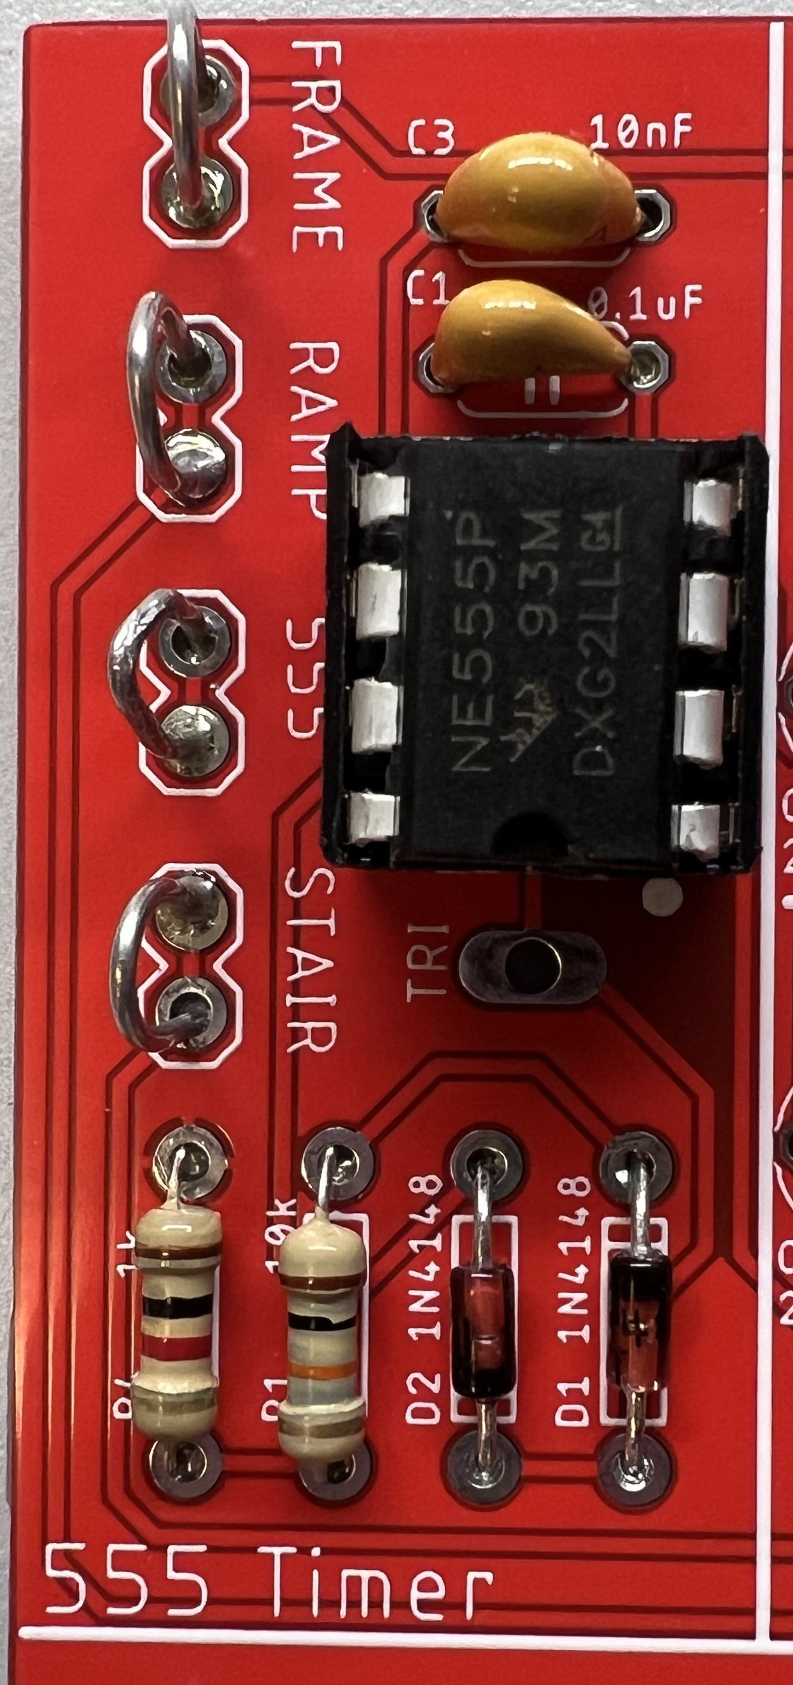
Test your circuit
Probe output 555 loop yellow trace
Probe TRI TRI pad blue trace

Slide 10
Turn In
Answer listed questions
Save solutions as PDF
Due before start of lab next week
Every student builds their own board
Everyone brings their board to class
Sign your board with your name!

